Slide 1
2D ARRAYS

Slide 2
Objectives
To learn and appreciate the following concepts
2D Array declaration, initialization
Programs using 2D arrays

Slide 3
Session outcome
At the end of session student will be able to
Declare, initialize and access 2D array
Write programs using 2D array

Slide 4
2 dimensional Array
It is an ordered table of homogeneous elements.
It can be imagined as a two dimensional table made of elements, all of them of a same uniform data type.
It is generally referred to as matrix, of some rows and some columns.
It is also called as a two-subscripted variable.
Notes:
Two Dimensional Array" is a simple form of multi-dimensional array that stores the array elements in a row, column matrix format.
Syntax: type array_name[array_size1][array_size2]

Slide 5
2 dimensional Arrays
For example
int marks[5][3];
float matrix[3][3];
char page[25][80];
The first example tells that marks is a 2-D array of 5 rows and 3 columns.
The second example tells that matrix is a 2-D array of 3 rows and 3 columns.
Similarly, the third example tells that page is a 2-D array of 25 rows and 80 columns.
Notes:
While one-dimensional arrays allow data to be placed in an array one row at a time, two-dimensional arrays are capable of storing data in both rows and columns. To accomplish this, each row in a two-dimensional array is associated with the number of columns defined for the array

Slide 6
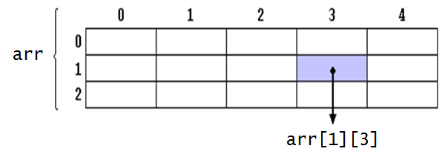
2 dimensional Arrays
Declaration
type array_name[row_size][column_size];
For example,
int arr [3][5];
arr represents a two dimensional array or table having 3 rows and 5 columns and it can store 15 integer values.

Slide 7
2 Dimensional Arrays
Initialization of two dimensional arrays
type array-name [row size] [col size ] ={list of values};
int table [2][3]={0,0,0,1,1,1};
→ initializes the elements of the first row to zero and the second row to 1.
Initialization is always done row by row.
The above statement can be equivalently written as
int table [2][3]={{0,0,0},{1,1,1}};
OR in matrix form it can be written as
int table [2][3]= { {0,0,0},
{1,1,1} };

Slide 8
2 Dimensional Arrays
When array is completely initialized with all values, need not necessarily specify the first dimension.
int table [][3]= { {0,0,0},
{1,1,1 }
};
If the values are missing in an initializer, they are set to zero
int table [2][3]= { {1,1},
{2}
};
will initialize the first two elements of the first row to 1, the first element of the second row to two, and all other elements to zero.
To set all elements to zero
int table [3][3]={{0},{0},{0}};

Slide 9
Read a matrix and display it
int main()
{
int i, j, m, n, a[100][100];
printf("enter dimension for a:“);
scanf(“%d %d”,&m,&n);
printf(“\n enter elements\n“);
for(i=0;i<m;i++)
{
for(j=0;j<n;j++)
scanf(“%d”, &a[i][j]);
}
for(i=0;i<m;i++)
{
for(j=0;j<n;j++)
printf(“%d\t”,a[i][j]);
printf(“\n”);
}
return 0;
}

Slide 10
Addition of two Matrices
#include<stdio.h>
#include<stdlib.h>
int main()
{
int i, j, m, n, p, q, a[10][10], b[10][10], c[10][10];
printf("enter dimension for a \n“);
scanf(“%d %d”,&m,&n);
printf("enter dimension for b\n“);
scanf(“%d %d”,&p,&q);
if (m!=p||n!=q)
{
printf("cannot add \n“);
exit(0); }
//Reading the elements
printf("enter elements for a \n“);
for (i=0;i<m;i++)
for(j=0;j<n;j++)
scanf(“%d”,&a[i][j]);

Slide 11
Matrix Addition
printf("\n enter elements for b\n)";
for(i=0;i<p;i++)
for(j=0;j<q;j++)
scanf(“%d”, &b[i][j]);
//Addition
for(i=0;i<m;i++)
for(j=0;j<n;j++)
c[i][j]=a[i][j]+b[i][j];
//Display
printf("\n final matrix is \n“);
for(i=0;i<m;i++)
{
for(j=0;j<n;j++)
printf(“%d”,c[i][j]);
printf("\n“);
}

Slide 12
Row Sum & Column Sum of a matrix
int a[10][10];
int rowsum[10], colsum[10];
printf("enter dimension for a \n“);
scanf(“%d %d”,&m, &n);
//Reading
printf("enter elements for a \n“);
for (i=0;i<m;i++){
for(j=0;j<n;j++)
scanf(“%d”, &a[i][j]);
}
//Row sum
for(i=0;i<m;i++)
{
rowsum[i]=0;
for(j=0;j<n;j++)
rowsum[i]=rowsum[i]+a[i][j];
}
printf("\n“);

Slide 13
Row Sum & Column Sum of a matrix
//Display
for(i=0;i<m;i++) {
for(j=0;j<n;j++)
printf("\t %d",a[i][j]);
printf(“→")
printf(“%d\n”,rowsum[i]);
}
printf("\n");
for(i=0;i<n;i++)
printf("\t %d",colsum[i]);
//Column sum
for(j=0;j<n;j++)
{
colsum[j]=0;
for(i=0;i<m;i++)
colsum[j]=colsum[j]+a[i][j];
}

Slide 14
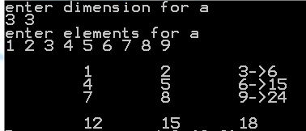
Row Sum & Column Sum of a matrix

Slide 15
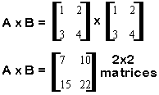
Multiplication of two Matrices
printf("enter elements for a \n“);
for (i=0;i<m;i++)
{
for(j=0;j<n;j++)
scanf(“%d”, &A[i][j]);
}
printf("\n enter elements for b\n“);
for(i=0;i<p;i++)
{ for(j=0;j<q;j++)
scanf(“%d”, &B[i][j]);
}
#include <stdio.h>
int main(){ int i, j, m, n, p, q;
int A[10][10], B[10][10],C[10][10];
printf("enter dimension for a \n“);
scanf(“%d %d”, &m, &n);
printf("\n enter dimension for b\n“);
scanf(“%d %d”, &p, &q);
if(n!=p){
printf("not multiplicable \n“);
exit(0); }

Slide 16
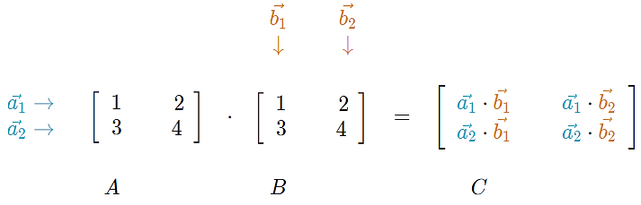
Multiplication of two Matrices
for(i=0;i<m;i++) {
for(j=0;j<q;j++) {
C[i][j]=0;
for(k=0;k<n;k++)
C[i][j]=C[i][j]+A[i][k]*B[k][j];
}
}
printf("\n The product matrix is \n“);
for(i=0;i<m;i++){
for(j=0;j<q;j++)
printf(“%d\t“, C[i][j]);
printf("\n“);
}

Slide 17
Trace and Norm of a Matrix
Trace is sum of principal diagonal elements of a square matrix.
Norm is Square Root of sum of squares of elements of a matrix.
int trace=0, sum=0,i,j,norm;
int m=3,n=3;
printf(“enter elements for a \n“);
for (i=0;i<m;i++){
for(j=0;j<n;j++)
scanf(“%d”,&a[i][j]);
}
for(i=0;i<m;i++)
trace=trace + a[i][i];
for(i=0;i<m;i++){
for(j=0;j<n;j++)
sum=sum + a[ i ][ j]*a[ i ][ j ];
}
norm=sqrt(sum);
printf(“ trace is %d”, trace );
printf(“ norm is %d”, norm );

Slide 18
Check whether a given Matrix is Symmetric or not
printf("enter dimension \n“);
scanf(“%d %d”,&m,&n);
if(m!=n){
printf(“Enter a square matrix \n“);
exit(0);
}
printf("enter elements \n“);
for(i=0; i<m; i++)
for(j=0; j<n; j++)
scanf(“%d”, &a[i][j]);
for(i=0; i<m; i++){
for(j=0; j<n; j++){
if (a[ i ][ j ] != a[ j ][ i ])
{
printf("\n Not symmetric \n”);
exit(0);
}
}
}
printf("\n Matrix is symmetric“);
return 0;
}

Slide 19
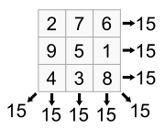
Problem…
Write program to check the given matrix is a magic square or not
A magic square of order n is an arrangement of n² numbers, usually distinct integers, in a square, such that the n numbers in all rows, all columns, and both diagonals sum to the same constant.
A normal magic square contains the integers from 1 to n².

Slide 20
Magic Square
//Matrix is Magic square or not
void main()
{
int mag[10][10], i, j, row, col, rowsum[10], colsum[10];
int pd=0, sd=0, k, x=0, b[100];
clrscr();
printf("enter dimension \n“);
scanf(“%d %d”,&row,&col);
if(row!=col) // checking for square matrix
{
printf(“matrix is not square”);
exit(0);
}
8 1 6
3 5 7
4 9 2
6 1 8
7 5 3
2 9 4

Slide 21
Magic Square
//inputting elements to the array
printf("\n enter elements for a \n“);
for(i=0; i<row; i++)
{
for(j=0; j<col; j++)
scanf(“%d”,&mag[i][j]);
}
//copying elements to 1D
for(i=0; i<row; i++)
for(j=0; j<col; j++)
b[x++]=mag[i][j];
//checking for uniqueness
for(k=0; k<x-1; k++)
for(j=k+1; j<x; j++)
if(b[k]==b[j])
{
printf(“elements are no distinct\n”);
printf(“matrix is not magic”);
exit(0);
}

Slide 22
Magic Square
//Finding sum of elements on principal Diagonal
for(i=0; i<row; i++)
pd=pd + mag[i][i];
//Row sum
for(i=0; i<row; i++)
{
rowsum[i]=0;
for(j=0;j< col; j++)
rowsum[i]=rowsum[i]+mag[i][j];
//comparing rowsum and principal diagonal sum
if(rowsum[i]!=pd)
{
printf(“matrix is not magic”);
exit(0);
}
}

Slide 23
Magic Square
//Finding column sum
for(i=0;i<col;i++)
{ colsum[i]=0;
for(j=0;j<row;j++)
colsum[i]=colsum[i]+mag[j][i];
//comparing Columnsum and principal diagonal sum
if(colsum[i]!=pd){ printf(“matrix is not magic”);
exit(0);
}
}

Slide 24
Magic Square
//finding secondary diagonal sum
i=row-1;
k=i;
for(j=col-1;j>=0;j--,i--)
sd=sd+mag[i][k-j];
if(sd!=pd) {
printf(“matrix is not magic”);
exit(0);
}
printf(“Matrix is magic\n”);
return 0;
}

Slide 25
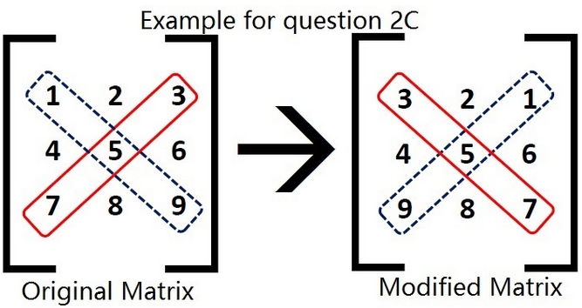
Exchange the elements of principal diagonal with secondary diagonal in an N dimensional Square matrix
for(i=0; i<n; i++)
for(j=0; j<n; j++)
if(i==j){
temp=arr[i][j];
arr[i][j]=arr[i][n-i-1];
arr[i][n-i-1]=temp;
}
printf("\nModified Matrix:\n“);
for(i=0;i<n;i++){
for(j=0;j<n;j++)
printf(" “);
printf(“%d”,arr[i][j]);
printf("\n“);
}
return 0;
}
int main(){
int i, j, temp, arr[4][4],n;
printf("\nEnter dimension: “);
scanf(“%d”,&n);
printf(“\nEnter elements:\n");
for(i=0; i<n; i++)
for(j=0; j<n; j++)
scanf(“%d”, arr[i][j]);

Slide 26
Exchange the Rows and Columns of a ‘mxn’ matrix
/*read ‘mxn’ matrix */
printf("\nEnter the rows to exchange: “);
scanf(“%d %d”,&r1,&r2);
/*Row exchange r1 ⬄ r2 */
for(j=0;j<n;j++) {
temp=arr[r1-1][j];
arr[r1-1][j]=arr[r2-1][j];
arr[r2-1][j]=temp;
}
printf(“\nEnter the cols to exchange: “);
scanf(“%d %d”,&c1,&c2);
/*Column exchange : c1 ⬄ c2 */
for(i=0;i<m;i++) {
temp=arr[i][c1-1];
arr[i][c1-1]=arr[i][c2-1];
arr[i][c2-1]=temp;
}

Slide 27
Syntax
Declaration:
data-type array_name[row_size][column_size];
Initialization of two dimensional arrays:
type array-name [row size] [col size ] ={list of values};
Display a Matrix:
int a[100][100];
for(i=0;i<m;i++){
for(j=0;j<n;j++)
printf(“%d”,a[i][j]);
printf(“ “);
printf(“\n”);
}
Reading a Matrix:
int a[100][100];
for(i=0;i<m;i++)
{
for(j=0;j<n;j++)
scanf(“%d”,&a[i][j]);
}

Slide 28
Tutorials
Write a program to check whether the given matrix is sparse matrix or not.
Write a program to find the sum of the elements above and below diagonal elements in a matrix.
Write a program to find the determinant of a matrix.

Slide 29
Summary
2 Dimensional Arrays

